Slide 1
TEAM PHALANX
TerraGuard 🛡️🤖
Autonomous Cyber Defense for Operational Technology
📋 Project Proposal Presentation
AI and Robotics Capstone
Robert B. Thompson & Cesar Noriega
Notes:
Proposal presentation, Weeks 1 to 3. We are proposing to build TerraGuard, not demoing a finished system.

Slide 2
WEEK 1 · TEAM FORMATION
👥 Meet Team Phalanx
RB
Robert B. Thompson
CN
Olis Bahari
NA
Njeh Ababbio
Co-lead
Co-lead
Co-lead
Shares title and every
responsibility equally.
Shares title and every
responsibility equally.
Shares title and every
responsibility equally.
NG
Nichelle Graf
🧰 How we work
Co-lead
GitHub repo, issues, and milestones
Shared docs and design files
Weekly instructor consultations
Shares title and every
responsibility equally.
Notes:
Two-person team, equal roles. Student-proposed project under Option B.

Slide 3
WEEK 1–2 · PROJECT SELECTION
🎯 The project we propose
We propose TerraGuard, an AI cyber-defense system that watches an operational technology environment and detects cyber threats in near real time.
🏭 The warehouse is our test bench
🔐 It matches our passion
📈 The problem is real
We use a robotic warehouse as the OT environment. The focus is cyber defense, not robot automation.
Cybersecurity, with AI and robotics from our degree, applied to a real and growing problem.
OT attacks are rising fast, and detection is the weak point across the whole sector.
Notes:
One-line pitch straight from our proposal. Warehouse is the test environment; cyber defense is the point.

Slide 4
WHY THIS MATTERS
🚨 Operational technology is under attack
🔓 KNP Logistics, UK (2025)
📊 The bigger picture
Attackers guessed one weak password. No multi-factor login.
They moved sideways through the network with no alerts.
They encrypted the data and erased the backups.
The 158-year-old firm collapsed. About 700 people lost their jobs.
68%
of industrial ransomware in Q1 2025 hit manufacturing, the sector closest to warehouse automation.
⏱️ Hours
💡 The break-in was ordinary. The damage came from the quiet spread that no one caught in time. That gap is what TerraGuard closes.
Attacks spread in hours. Detection often takes far longer. Speed is the whole problem.
Sources: BBC / The Hacker News, KNP Logistics (2025). Dragos, OT Ransomware Trends Q1 2025.
Notes:
Lead with the human story, back it with the sector data. Both verified.

Slide 5
OUR PROPOSED SOLUTION
🛡️ Four parts, working as one defense
🔍
Anomaly detection
🧱
Assessment & hardening
Watches network and device behavior; flags what looks abnormal.
Scans the setup for weaknesses and ranks the fixes.
🤖
Robot integrity monitor
🎛️
Orchestration layer
Checks each robot command against its real motion.
Correlates findings, maps to the SOP, alerts the operator.
➡️ Output: a security dashboard plus the matching SOP for human review. TerraGuard detects and advises. A person decides.
Notes:
These four parts come straight from our proposal. Emphasize detect-and-advise, human decides.

Slide 6
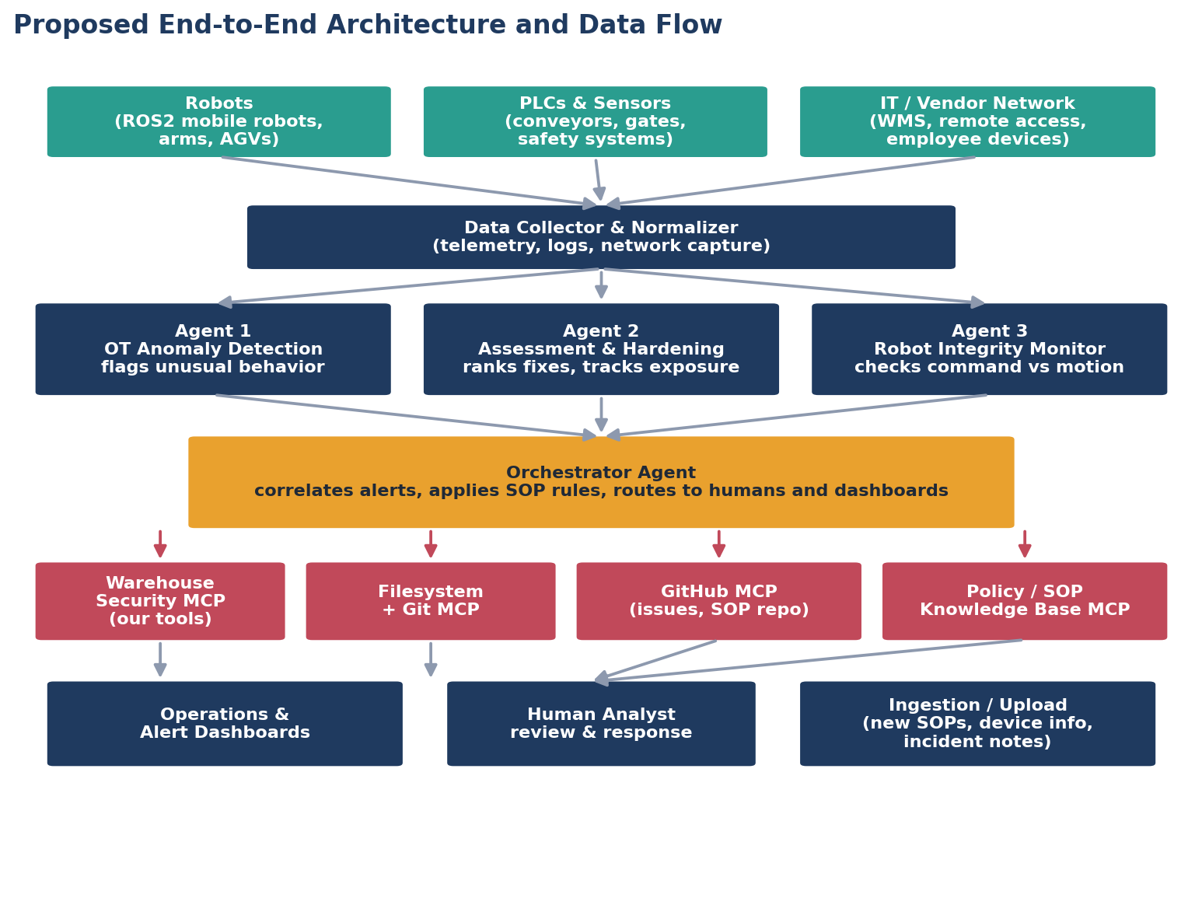
HOW IT WILL FIT TOGETHER
🧩 Proposed architecture
Robots, PLCs, and network traffic feed one collector.
Three agents will score the data in parallel.
The orchestrator correlates findings and applies SOP rules.
MCP servers connect the agents to tools and the SOP knowledge base.
Alerts reach a dashboard and, when critical, a person.
Notes:
Proposed design. Note MCP connects agents to tools; it does not store data.

Slide 7
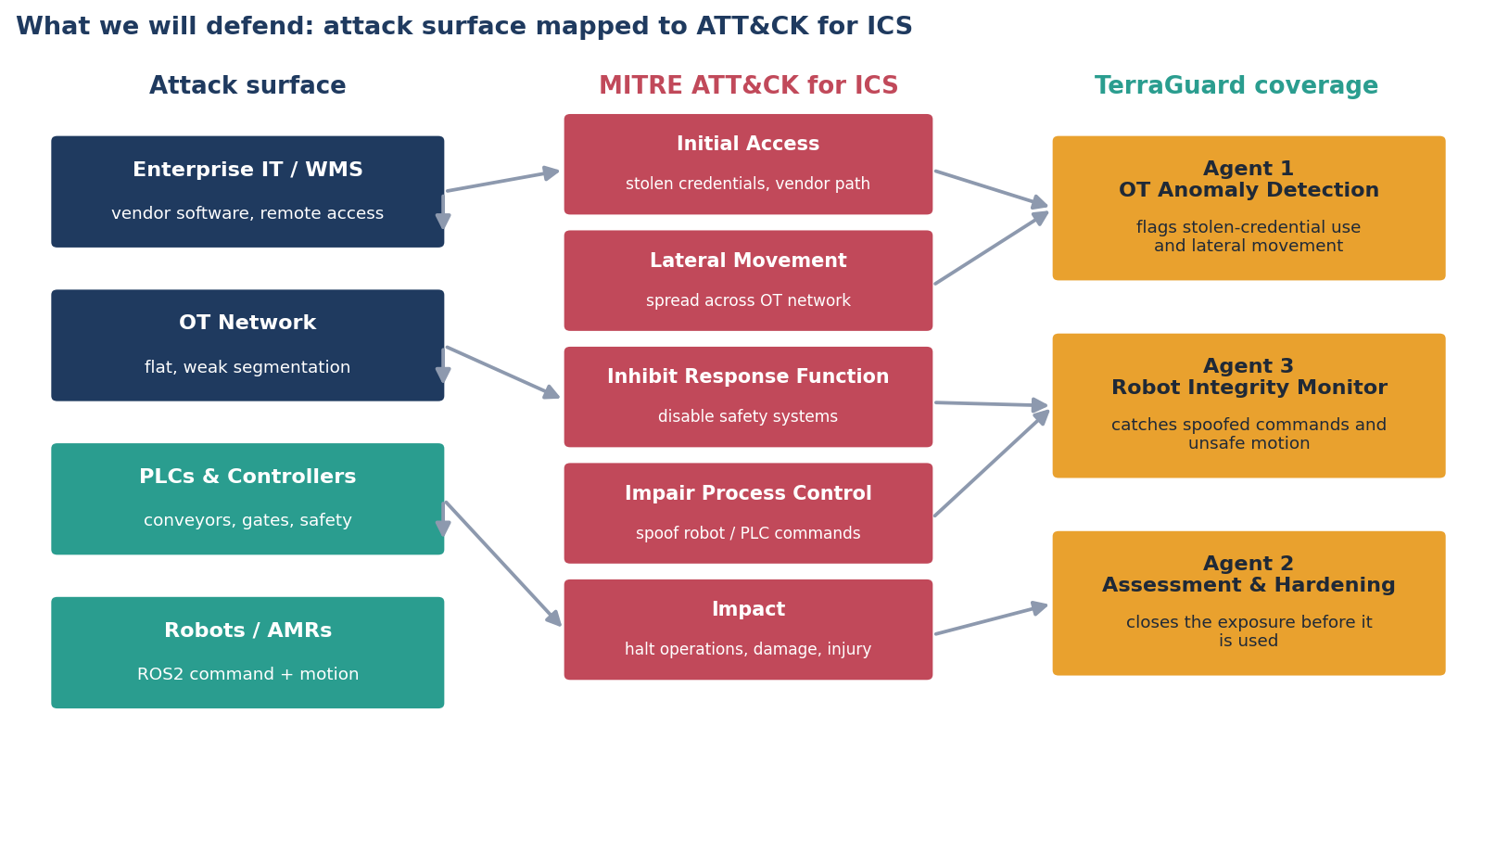
WHAT WE WILL DEFEND
🎯 Mapped to a real attack framework
Framework: MITRE ATT&CK for ICS. Attack surface reflects a typical robotic-warehouse OT environment.
Notes:
This slide proves the project is cybersecurity. Every attacker step maps to ATT&CK for ICS.

Slide 8
WEEK 2 · FEASIBILITY
✅ Can we build this in one semester? Yes.
✓
✓
📂
Data
🧰
Tools
Public OT and robot attack datasets exist. Synthetic data fills the gap.
Every tool is free and open-source.
✓
✓
💻
Compute
🎓
Skills
A laptop, free Google Colab, and the HCC lab cover it.
Our coursework covers machine learning, robotics, and security.
🔎 We keep scope realistic: a warehouse simulation, not a live plant.
Notes:
Feasibility check from Week 2. Scope control is the key message.

Slide 9
WEEK 2 · RESOURCES IDENTIFIED
🧰 What we will use
📂 Data
⚙️ Tools
💻 Compute & code
Real: SWaT, WADI, HAI (OT attacks)
Real: ROSIDS23, ROSPaCe (robot traffic)
Synthetic: ROS2 + Gazebo warehouse
Python, scikit-learn, PyOD
Zeek and Wireshark (network)
ROS2, Gazebo, Streamlit, FastMCP
Laptop and HCC lab machine
Google Colab for heavier training
GitHub with Git LFS
Notes:
Resource list from the proposal. All free, all reproducible.

Slide 10
WEEK 2 · BACKGROUND RESEARCH
📚 Standards and frameworks we build on
MITRE ATT&CK for ICS
MITRE ATLAS
The map of how attackers hit industrial systems.
The map of attacks aimed at AI systems themselves.
NIST SP 800-82 Rev. 3
IEC 62443
The guide to securing operational technology.
The international standard for ICS security.
🧠 We also studied real incidents (KNP, Blue Yonder, utility attacks). The lesson repeats: detection speed and OT visibility are the gaps.
Notes:
Frameworks ground our approach in accepted practice, not our own invention.

Slide 11
WEEK 3 · TECHNICAL APPROACH
⚙️ Three AI competencies, one defense
🧮 Machine + deep learning
💬 Natural language processing
🤖 Robotics
OT anomaly detection. Isolation Forest baseline, with a deep model for sequence behavior.
LLM triage. Turns a raw alert into a plain explanation and maps it to an attack technique.
Robot integrity. Reads ROS2 command and motion, and checks that they match.
🔗 Method: analyze network traffic, device behavior, configuration, and robot telemetry, then correlate the severity and stage of a possible attack.
Notes:
Ties the AI competencies from our degree to the defense. Method line is from the proposal.

Slide 12
WEEK 3 · TIMELINE & MILESTONES
🗓️ Four phases to a working prototype
📍 We are here
1
2
3
4
Proposal & planning
›
Data pipeline
›
Build & integrate
›
Demo & deploy
Scope, architecture, data sources, security requirements.
Prepare and validate the datasets.
Agents, orchestrator, SOP knowledge base, dashboard.
Test with controlled attack scenarios; final demonstration.
Notes:
Four phases from the proposal. We are at the end of phase 1.

Slide 13
WEEK 3 · SUCCESS METRICS
📊 How we will measure success
🎯
Detection recall
🔕
False-positive rate
⏱️
Alert-to-human time
Catch real attacks in the test data.
Keep the noise low, tracked over time.
Under a target for critical alerts.
Dwell-time reduction
These are security metrics. Recall on real attacks matters more than raw accuracy.
📉
📋
SOP compliance
Cut attacker time versus no tool.
The right procedure reaches the operator.
Notes:
Metrics straight from the proposal. Emphasize recall-first.

Slide 14
WEEK 3 · RISK ASSESSMENT
⚠️ Risks and how we reduce them
Risk
How we reduce it
False positives
Cross-check agents; tune thresholds; runbook guides tuning
Missed attacks
Multiple detection methods; recall-first metric
Loss of monitoring data
Treat the gap as a blind spot; runbook recovery steps
AI model errors
Human review; validate before rollout
Prompt injection, data poisoning
Treat inputs as data; verify data source; AI-threat SOPs
Physical safety
A human approves every action; hardware safety stays independent
Notes:
Risk table from the proposal, including AI-specific threats, each with a mitigation.

Slide 15
WEEK 3 · ETHICS & SAFETY
🧭 The lines we hold
🛡️
Defensive only
🙋
A human decides
TerraGuard detects and assesses. It never gives instructions for an attack.
The system advises. A person approves every physical action.
🧯
Safety stays independent
⚖️
Safety outranks security
Hardware safety and emergency stops work even if the AI is offline.
If the two ever conflict, protecting people comes first.
Notes:
Ethics section from the proposal. Defensive-only and safety-first are the anchors.

Slide 16
EXPECTED RESULT & NEXT STEP
🚀 What we will deliver
A working prototype of TerraGuard that detects abnormal behavior, assesses the threat, maps it to the right SOP, and gives a human operator clear, actionable information, all in a simulated robotic warehouse.
🎬
🔜
📦
Final demo
Next phase
End goal
We will simulate a live attack and show detect → assess → map to SOP → alert.
Build the data pipeline: gather, clean, and validate the datasets.
A public GitHub repo anyone can download, install, and test.
Thank you. Team Phalanx · Robert B. Thompson & Cesar Noriega 🛡️
Notes:
Close on the concrete prototype and the next step. Keep it forward-looking; nothing is built yet.

Slide 17
References
Dragos. OT Ransomware Trends: Q1 2025 Analysis (manufacturing 480 incidents, 68% of industrial ransomware).
BBC News and The Hacker News. KNP Logistics ransomware collapse, 2025.
NIST. Special Publication 800-82 Revision 3, Guide to Operational Technology (OT) Security.
IEC 62443. Industrial automation and control systems security standard series.
MITRE. ATT&CK for ICS knowledge base. MITRE ATLAS, adversarial threat landscape for AI systems.
iTrust, Singapore University of Technology and Design. SWaT, WADI, and HAI datasets.
ROSIDS23 and ROSPaCe. ROS2 intrusion-detection datasets.
Sources accessed September 2026.

